Slide 1
Using Response Objects
Name: B.vishnu vishal
Branch: CSE
Roll no.: 22H51A0510

Slide 2
Introduction to Response Objects
Response objects are crucial in web development for handling data communication.
These objects facilitate the transfer of data between a client and a server.
Understanding response objects is essential for building efficient web applications.
1
Notes:
Image source: https://www.vrogue.co/post/6-the-request-and-response-objects-web-development-with-node-and

Slide 3
What is a Response Object?
A response object represents the data sent back to the client from the server.
It contains information like status codes, headers, and the response body.
Response objects enable developers to control the output of server-side applications.
2
Notes:
Image source: https://www.slideserve.com/rama-powell/jsp-powerpoint-ppt-presentation

Slide 4
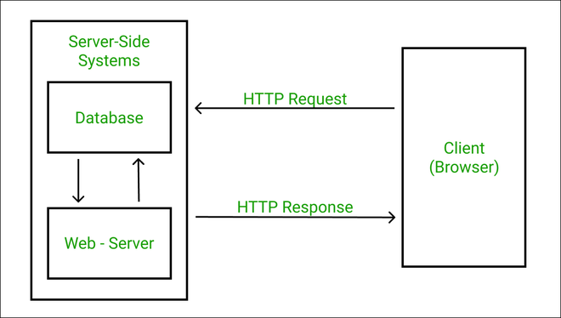
Components of Response Objects
Key components include status codes, headers, and message body content.
Status codes indicate the success or failure of the request.
Headers provide additional context and metadata about the response.
3
Notes:
Image source: https://www.geeksforgeeks.org/state-the-core-components-of-an-http-response/

Slide 5
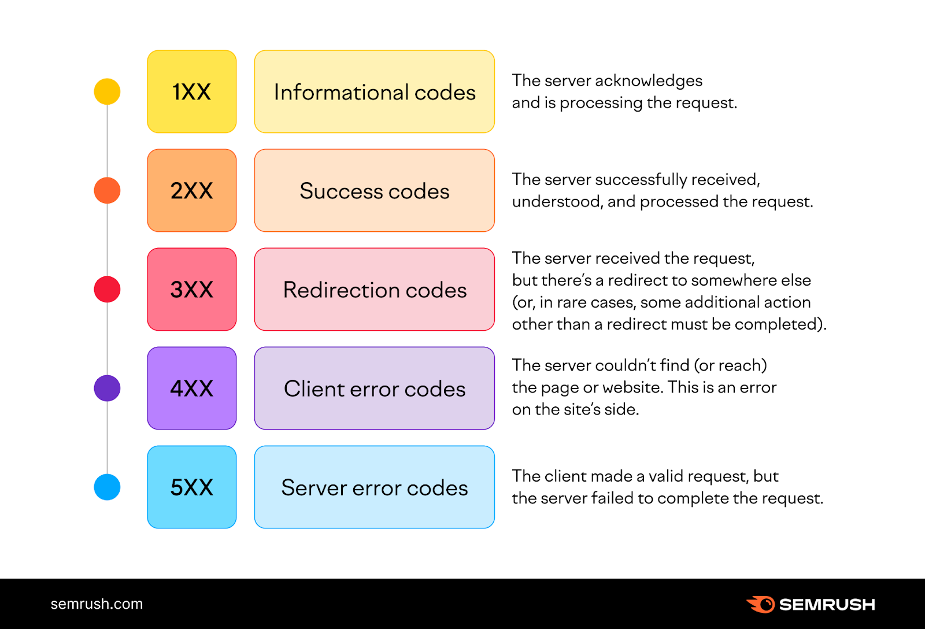
Status Codes
Status codes are three-digit numbers that classify the response.
Common status codes include 200 (OK), 404 (Not Found), and 500 (Internal Server Error).
Each status code conveys specific information about the outcome of the request.
4
Notes:
Image source: https://www.semrush.com/blog/http-status-codes/?kw=&cmp=AU_SRCH_DSA_Blog_EN&label=dsa_pagefeed&Network=g&Device=c&kwid=dsa-1754723155433&agpid=145078200167&BU=Core&extid=60162892887&adpos=&gad=1

Slide 6

Importance of Headers
Headers carry essential information such as content type and caching policies.
They can also include security-related data like authentication tokens.
Properly setting headers can enhance the performance and security of applications.
5
Notes:
Image source: https://www.invicti.com/blog/web-security/importance-content-type-header-http-requests/

Slide 7
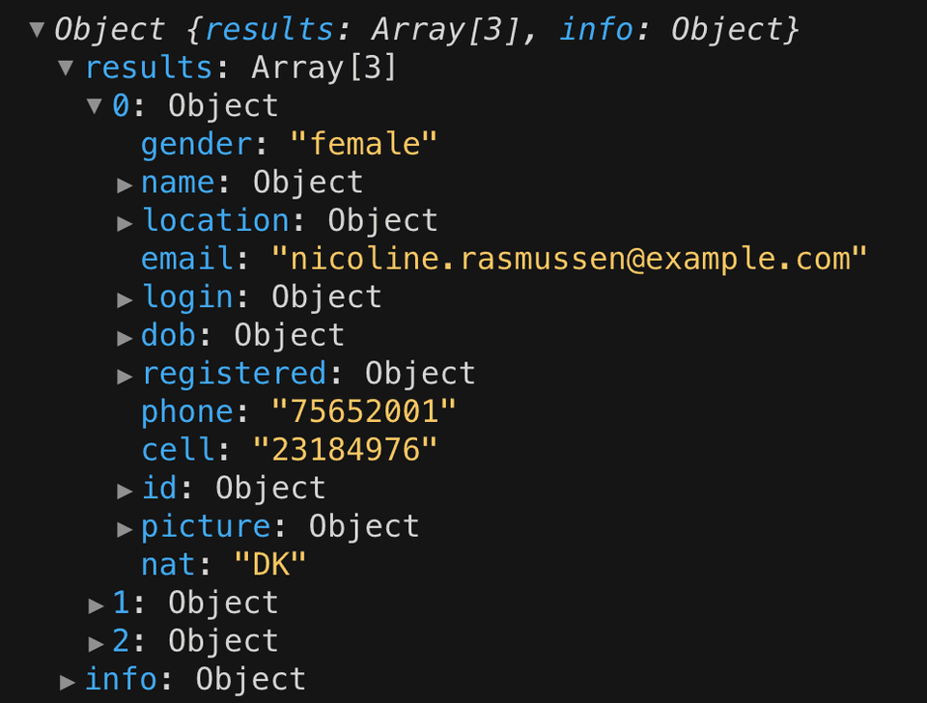
Creating a Response Object
Response objects can be created using frameworks like Express.js in Node.js.
Developers can use methods like `res.send()` or `res.json()` to send responses.
This flexibility allows for easy handling of various data formats.
6
Notes:
Image source: https://jschris.com/getting-started-with-react

Slide 8
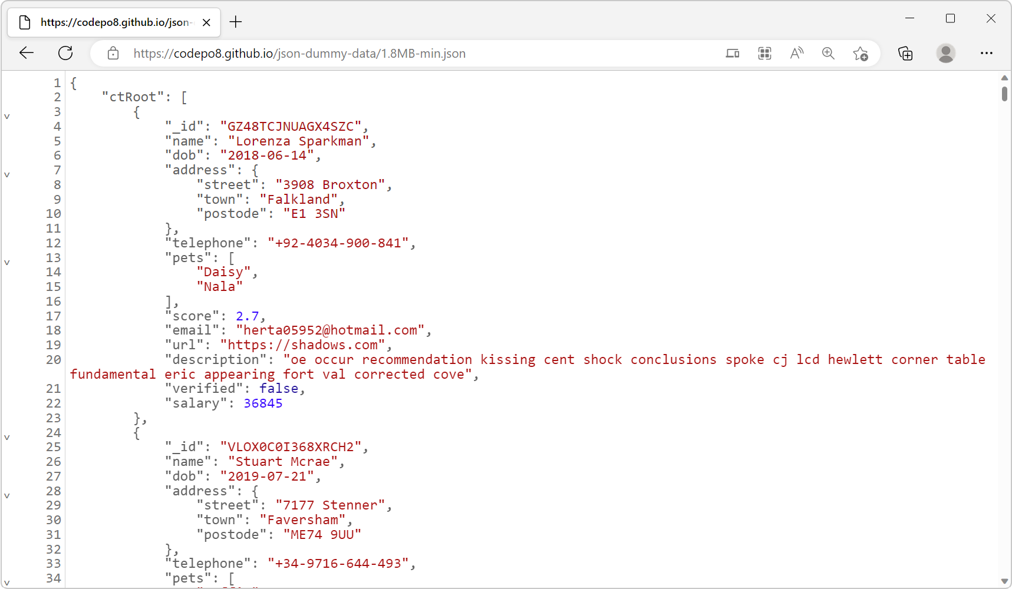
Sending JSON Responses
JSON is a widely used format for data interchange in web applications.
Response objects provide a `res.json()` method for sending JSON data easily.
This method automatically sets the correct content type header.
7
Notes:
Image source: https://devtoolstips.org/tips/en/see-json-responses/

Slide 9

Sending HTML Responses
HTML responses can be sent using the `res.send()` method.
This is helpful for rendering web pages directly from server-side code.
Developers can embed dynamic content within HTML for a personalized experience.
8
Notes:
Image source: https://codetofun.com/express/res/send/

Slide 10
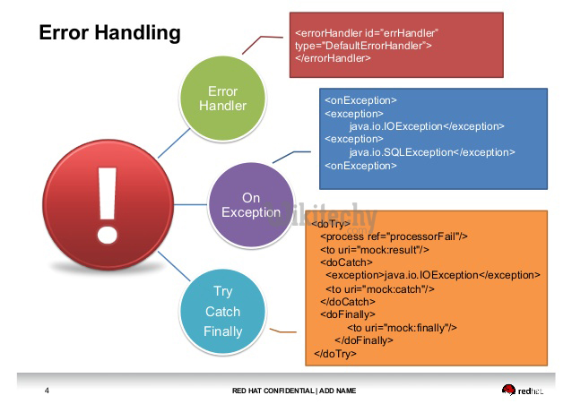
Handling Errors with Response Objects
Proper error handling is crucial for user experience and debugging.
Developers can use `res.status()` to set appropriate error status codes.
Including error messages in the response body provides clarity for clients.
9
Notes:
Image source: https://www.wikitechy.com/tutorials/laravel/laravel-error-handling

Slide 11
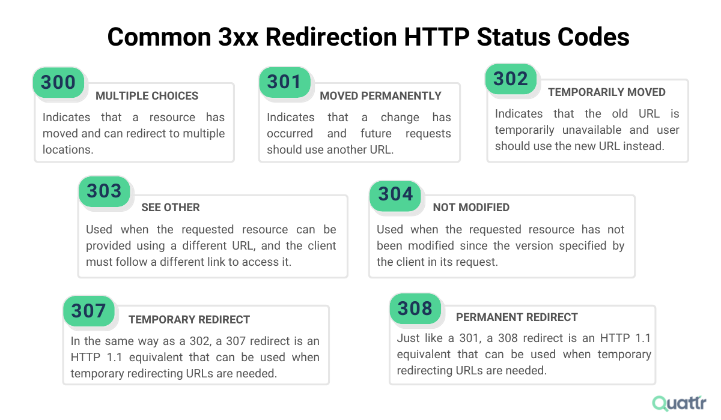
Common Mistakes with Response Objects
Forgetting to set status codes can lead to confusion for clients.
Overloading responses with excessive data can degrade performance.
Failing to handle errors properly can result in a poor user experience.
10
Notes:
Image source: https://www.quattr.com/enhance-experience/http-status-codes-explained

Slide 12

Conclusion
Response objects are a foundational concept in web application development.
Mastering their use can lead to more efficient and user-friendly applications.
Continued learning and adaptation will ensure developers stay ahead in the field.
11
Notes:
Image source: https://techtrendingblogs.blogspot.com/2020/12/web-application-development-definitive.html

Slide 13
THANK YOU

